Slide 1
Artificial Intelligence
By: Prabdeep Gill

Slide 2
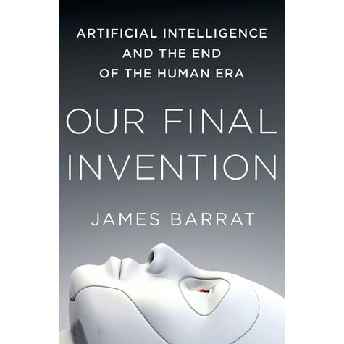
Text
Our Final Invention by James Barrat

Slide 3
Definition of AI
“The art of creating machines that perform functions that require intelligence when preformed by people.” – Kurzwell 1990
“The branch of computer science that is concerned with the automation of intelligent behavior.” - Luger & Stublefield 1993
1. Systems think like and act like humans.
2. Systems that act and think rationally.

Slide 4
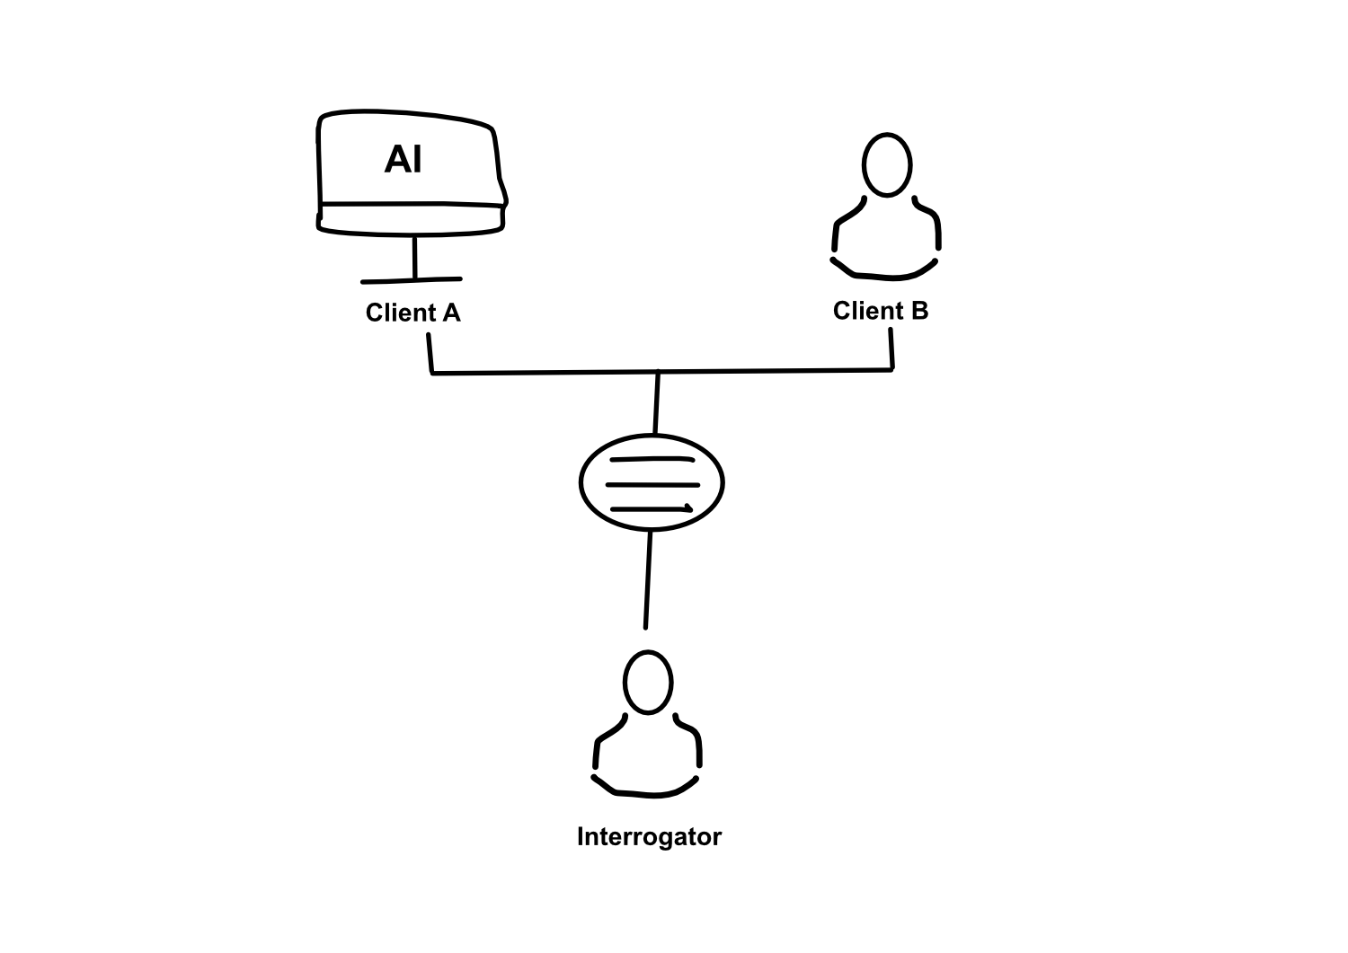
Acting Humanly: The Turing Test
If the response of a computer to an unrestricted textual natural-language conversation cannot be distinguished from that of a human being then it can be said to be intelligent.

Slide 5
Thinking Humanely: Cognitive Modeling
Method must not just exhibit behavior sufficient to fool a human judge but must do it in a way demonstrably analogous to human cognation.
Requires detailed matching of computer behavior and timing to detailed measurements of human subjects gathered in psychological experiments.
Cognitive Science: Interdisciplinary field that tries to form computational theories of human cognition. (AI falls into this big time)

Slide 6
Thinking Rationally: Laws of Thought
Formalize “correct” reasoning using mathematical model. (an example of this is deductive reasoning)
Logicist Program: Encode knowledge in formal logical statements and use mathematical deduction to preform reasoning.
Problems:
Formalizing common sense knowledge is difficult
General deductive inference is computationally intractable

Slide 7
Acting Rationally: Rational Agents
An agent is an entity that perceives its environment and is able to execute actions to change it.
Agents have inherent goals that they want to achieve. (ex. desire, survive reproduce)
A rational agent acts in a way to maximize achievement of its goals.
True maximization of goals requires omniscience and unlimited computational abilities.
Limited rationally involves maximizing goals within the computational and other resources.

Slide 8
Foundations of AI
Many older disciplines contribute to a foundation for artificial intelligence:
Philosophy: logic, philosophy of the mind/science/mathematics
Mathematics: logic, probability theory, theory of computability
Psychology: behaviorism, cognitive psychology
Computer Science & Engineering: hardware, algorithms, computational complexity theory
Linguistics: theory of grammar, syntax, semantics

Slide 9
The Beginnings
McCullouch and Pitts (1943) theory of neurons as logical computing circuits.
Work in the early 50s by Claude Shannon and Turing on game playing and Marvin Minsky on neural networks.

Slide 10
Dartmouth Conference (1956)
Organized by John McCarthy attended by Marvin Minsky, Allen Newell, Herb Simon, and a few others.
Coined the term “artificial intelligence”
Presentation of game playing programs and Logic Theorist

Slide 11
Early Year Examples
Development of General Problem Solver by Newell and Simon in early sixties.
Arthur Samuel’s late fifties work on learning to play checkers.
Frank Rosenblatt’s Perceptron (1962) for training simple neural networks.

Slide 12
More Notable Findings
Developments from Marvin Minsky & John McCarthy
Development of LISP symbolic programming language
SAINT: Solved freshman calculus problems
ANALOGY: Solved IQ test analogy problems
SIR: Answered simple questions in English
STUDENT: Solved algebra story problems
SHRDLU: Obeyed simple English commands in the blocks world

Slide 13
Early Limitations
Hard to scale solutions to toy problems to more realistic ones due to difficulty formalizing knowledge and combinatorial explosion of search space of potential solutions.
Limitations of Perceptron demonstrated by Minsky & Papert (1969)

Slide 14
Expert Systems
Discovery that detailed knowledge of the specific domain can help control search and lead to expert level performance on restricted tasks.
Find expert system DENDRAL for interpreting mass spectrogram data to determine molecular structure by Buchanan, Feigenbaum, and Lederberg (1969).

Slide 15
Evolution
Development of numerous expert systems in early eighties.
Estimated $2 billion industry by 1988.
Japanese start “Fifth Generation” project in 1981 to build intelligent computers based on Prolog logic programming.
MCC established in Austin in 1984 to counter Japanese project.
Limitations become apparent, prediction of AI Winter
-Brittleness and domain specificity
-Knowledge acquisition bottleneck

Slide 16
Rebirth of Neural Networks?
New algorithms discovered for training more complex neural networks (1986)
Cognitive modelling of many psychological processes using neural networks, e.g. learning language.
Industrial applications:
-Character and hand-writing recognition
-Speech recognition
-Processing credit card applications
-Financial prediction
-Chemical process control

Slide 17
Modern Day
General focus on learning and training methods to address knowledge-acquisition bottleneck.
Shift of focus from rule-based and logical methods to probabilistic and statistical methods. (ex Bayes nets, Hidden Markov Model)
Increased interest in particular areas: data mining, intelligent agents, internet applications, etc

